Slide 1
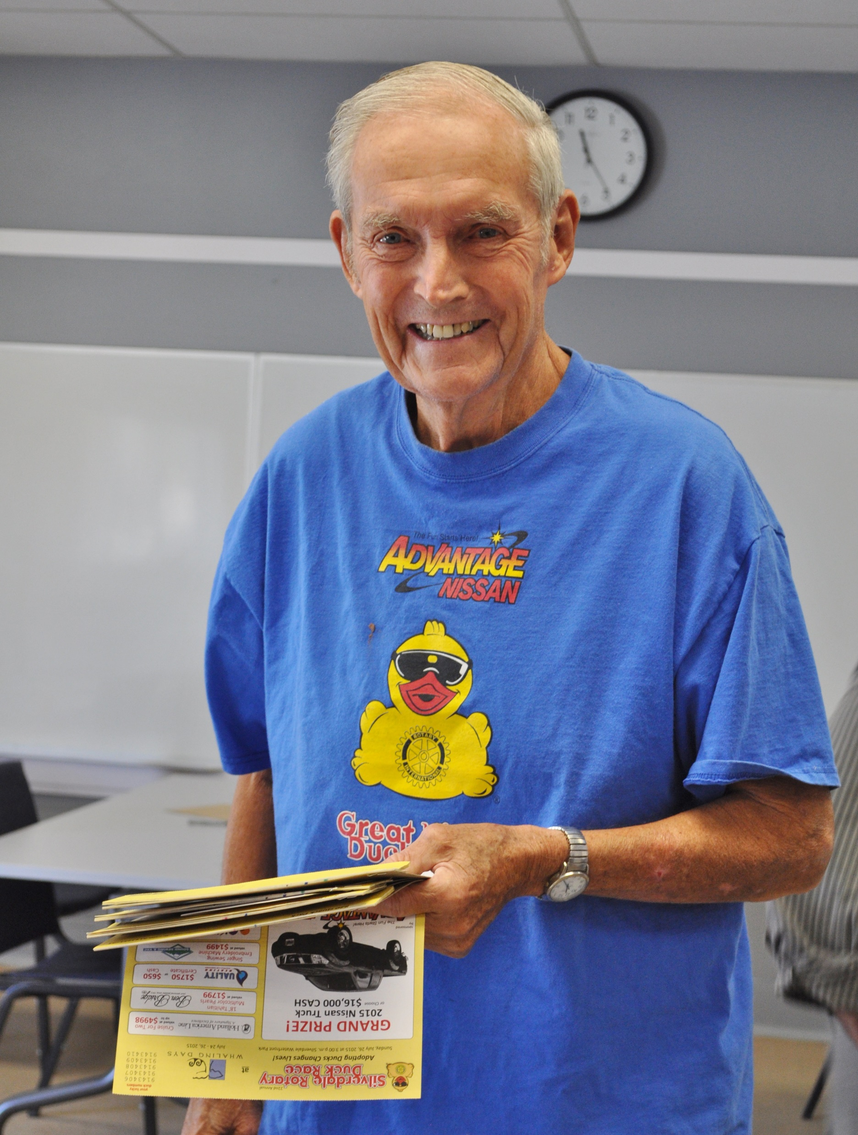
Jack Jensen Forever Rotary
Silverdale Rotary Club
1968-2020

Slide 2
Jack Jensen - April 3, 1929 to January 18, 2020
Silverdale Rotary Club 1968-2020
Club President – 1974-75
Duck Seller Extraordinaire
Paul Harris Fellow
Bell Ringer
3rd Grade Dictionary Presenter

Slide 3
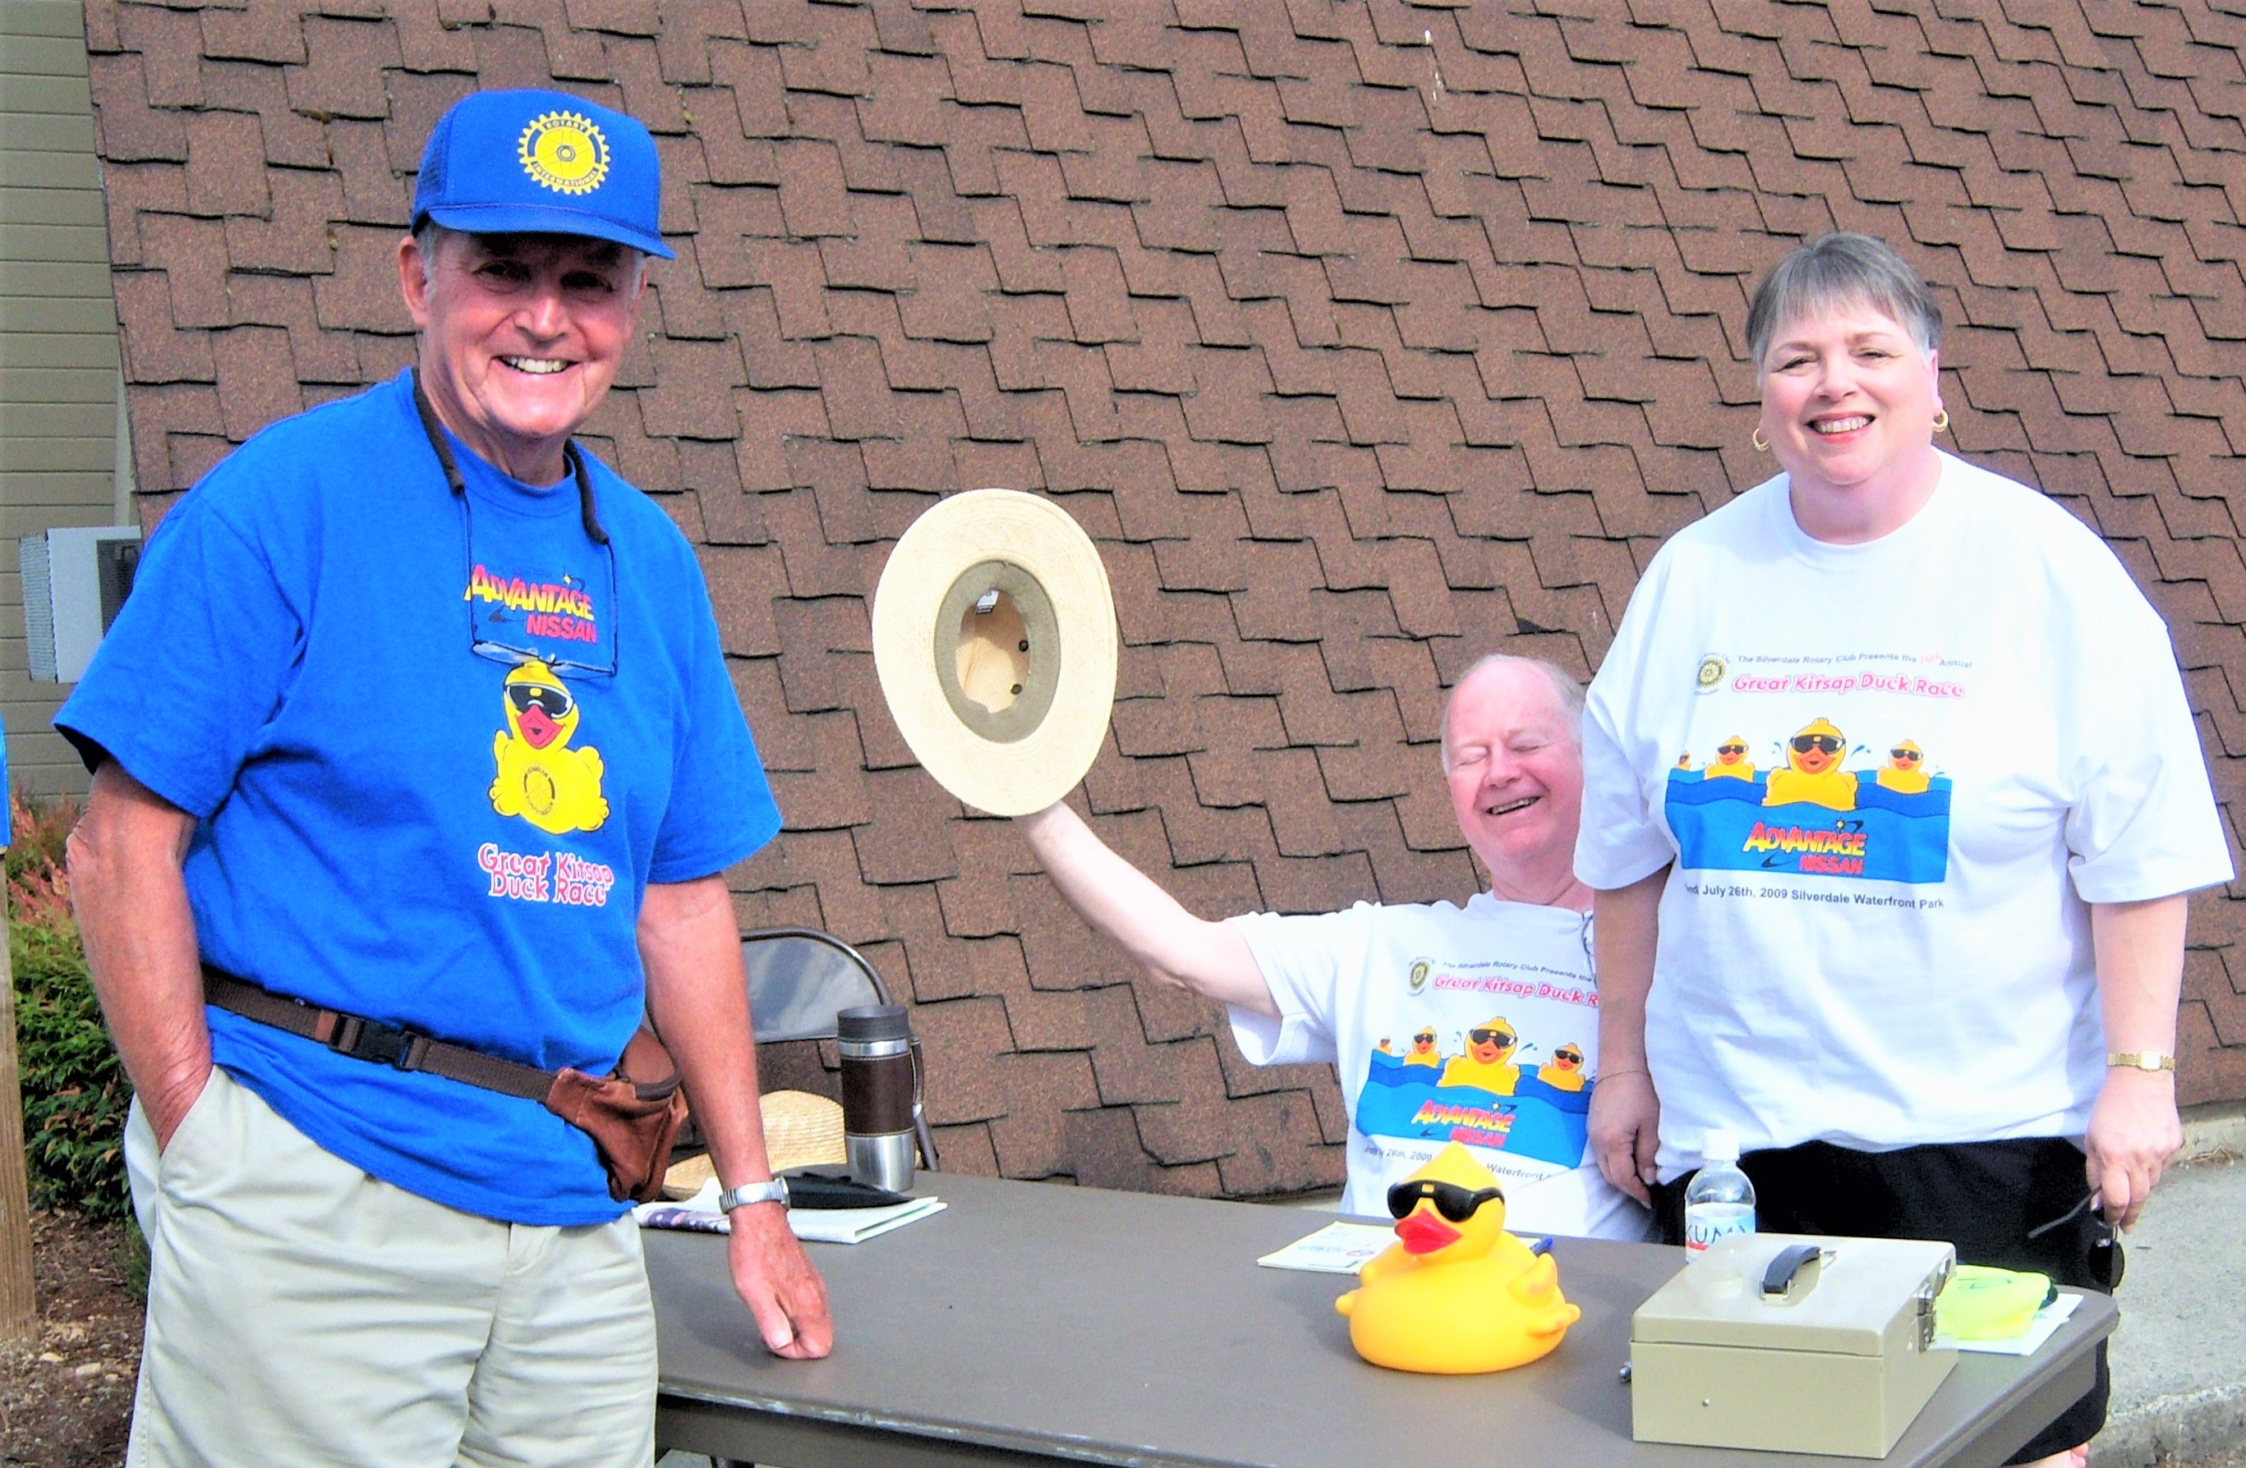
Video – Click on link below
https://www.youtube.com/watch?v=J-warW__YaE
Jack Selling Ducks with Steve and Elayne Burton - 2009

Slide 4
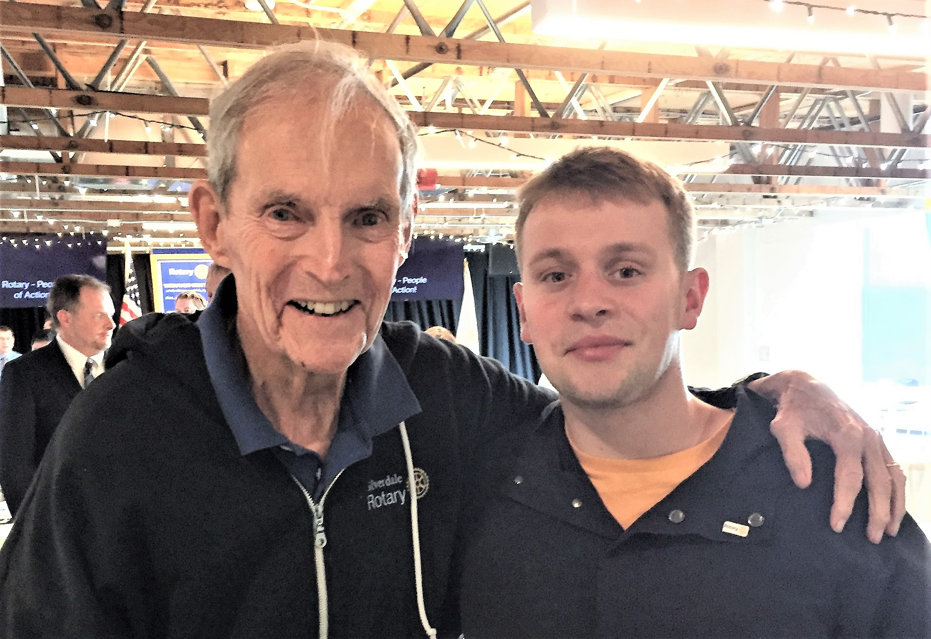
2019 – Oldest and Newest Silverdale Rotarian
Jack Jensen and Matej Kunak

Slide 5
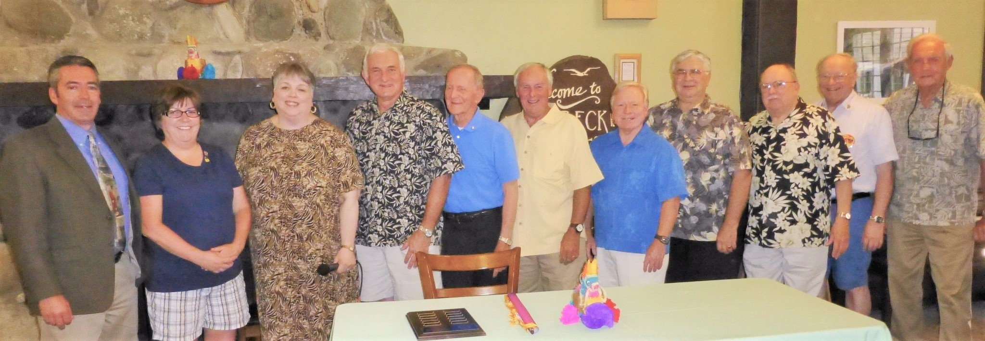
Past Presidents at 2017 Installation Dinner
Left to right: Ed Hamilton, Mary Hoover, Elayne Burton, Scott Slocum, Roger Aydt, Peter Matty, Ron Templeton, Larry Rodgers, Don Taylor, Brian Beagle, Jack Jensen

